Slide 1
Regression Techniques
(Overview)
Sounak Roy
Sep‘18

Slide 2
Regression Technique
What is regression ?
Regression analysis is a form of predictive modelling technique which investigates the relationship between a dependent (target) and independent variable (s) (predictor).
This technique is used for finding the relationship between the variables
Example:- Let’s say, you want to estimate growth in sales of a company based on current economic conditions. You have the recent company data which indicates that the growth in sales is around two and a half times the growth in the economy.
Using this insight, we can predict future sales of the company based on current &
past information.
It indicates the significant relationships between dependent variable and independent variable.
It indicates the strength of impact of multiple independent variables on a dependent variable.

Slide 3
Terminologies related to regression analysis
1. Outliers Suppose there is an observation in the dataset which is having a very high or very low value as compared to the other observations in the data, i.e. it does not belong to the population, such an observation is called an outlier. In simple words, it is extreme value. An outlier is a problem because many times it hampers the results we get. 2. Multicollinearity When the independent variables are highly correlated to each other then the variables are said to be multicollinear. Many types of regression techniques assumes multicollinearity should not be present in the dataset. It is because it causes problems in ranking variables based on its importance. Or it makes job difficult in selecting the most important independent variable (factor). 3. Heteroscedasticity When dependent variable's variability is not equal across values of an independent variable, it is called heteroscedasticity. Example - As one's income increases, the variability of food consumption will increase. A poorer person will spend a rather constant amount by always eating inexpensive food; a wealthier person may occasionally buy inexpensive food and at other times eat expensive meals. Those with higher incomes display a greater variability of food consumption.

Slide 4
4. Underfitting and Overfitting
When we use unnecessary explanatory variables it might lead to overfitting. Overfitting means that our algorithm works well on the training set but is unable to perform better on the test sets. It is also known as problem of high variance.
When our algorithm works so poorly that it is unable to fit even training set well then it is said to underfit the data. It is also known as problem of high bias.
5. Autocorrelation
It states that the errors associated with one observation are not correlated with the errors of any other observation. It is a problem when you use time series data.
Suppose you have collected data from type of food consumption in eight different states. It is likely that the food consumption trend within each state will tend to be more like one another that consumption from different states i.e. their errors are not independent.

Slide 5
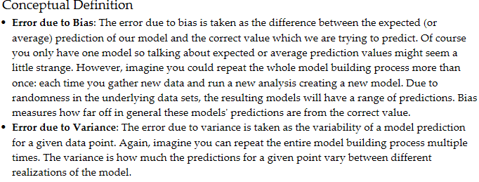
Bias –Variance

Slide 6
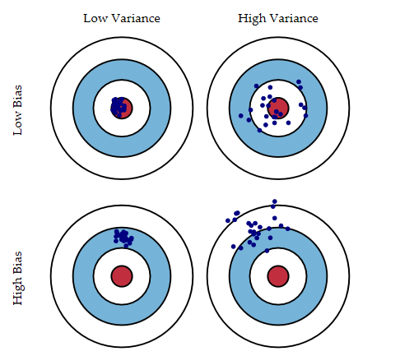
Imagine that the center of the target is a model that perfectly predicts the correct values. As we move away from the bulls-eye, our predictions get worse and worse.
Imagine we can repeat our entire model building process to get a number of separate hits on the target.
Each hit represents an individual realization of our model, given the chance variability in the training data we gather.
Sometimes we will get a good distribution of training data so we predict very well and we are close to the bulls-eye, while sometimes our training data might be full of outliers or non-standard values resulting in poorer predictions.

Slide 7
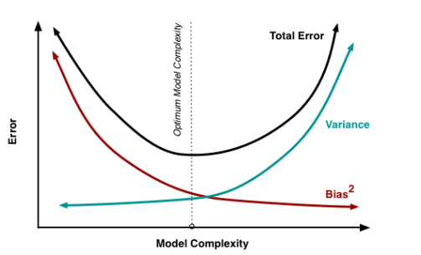
Bias-Variance Trade-Off:-
Bias is reduced and variance is increased in relation to model complexity. As more and more parameters are added to a model, the complexity of the model rises and variance becomes our primary concern while bias steadily falls.
For example, as more polynomial terms are added to a linear regression, the greater the resulting model's complexity will be . In other words, bias has a negative first-order derivative in response to model complexity ,while variance has a positive slope.

Slide 8
Ways to limit Overfitting & Underfitting problem
Select the most significant variables in the model, hence limiting the model complexity by having too many variables in the model
Cross-Validation Technique for sampling
Regularization by adding a penalty term

Slide 9
Link Function
A link function transforms the probabilities of the levels of a categorical response variable to a continuous scale that is unbounded. Once the transformation is complete, the relationship between the predictors and the response can be modeled with linear regression.
For example, a binary response variable can have two unique values. Conversion of these values to probabilities makes the response variable range from 0 to 1.
When you apply an appropriate link function to the probabilities, the numbers
that result range from −∞ to +∞.
The general form of the link function follows:
g(μ_{i}) = X_{i}'β

Slide 10
Link Functions
Models | Name | Link Function, g(μ_{i})
Binomial, Ordinal, Nominal | logit | ln(μ_{i}/(1−μ_{i}))
Binomial, Ordinal | normit (probit) | Φ⁻¹(μ_{i})
Binomial, Ordinal | gompit (complementary log-log) | ln(−ln(1−μ_{i}))
Poisson | natural log | ln(μ_{i})
Poisson | square root
Poisson | identity | μ_{i}
Description
g(μi) :- the link function
Μi :- the mean response of the ith row
Xi :-the vector of predictor variables for the ith row
Β :- the vector of coefficients associated with the predictors
Φ−1(·) :- the inverse cumulative distribution function of the normal distributionmal distribution

Slide 11
Types of Regressions
Linear Regression
Polynomial Regression
Logistic Regression
Quantile Regression
Ridge Regression
Lasso Regression
Elastic Net Regression
Principal Component Regression
Partial Least Square Regression
Support Vector Regression
Ordinal Regression
Poisson Regression
Negative Binomial Regression
Quasi-Poisson Regression
Cox Regression

Slide 12
Linear Regression
It is the simplest form of regression. It is a technique in which the dependent variable is continuous in nature. The relationship between the dependent variable and independent variables is assumed to be linear in nature.
Linear regression is a supervised learning algorithm because it uses true labels for training. Supervised learning algorithm should have input variable (x) and an output variable (Y) for each example
Since linear regression gives output as continuous values, so in such case we use mean squared error metric to evaluate the model performance
If Dependent Variable is Continuous and
Dependent Variable[1] → Independent variable [1] :- Simple linear regression.
Dependent Variable[1] → Independent variable [>1] :- Multiple linear regression
Dependent Variable[>1] → Independent variable [>1] :- Multi Variate regression

Slide 13
Example 1
Suppose that a university wishes to refine its admission criteria so that they admit 'better' students. Also, suppose that a student's grade Point Average (GPA) is what the university wishes to use as a performance metric for students. They have several criteria in mind such as high school GPA (HSGPA), SAT scores (SAT), Gender etc and would like to know which one of these criteria matter as far as GPA is concerned.
Solution: Multiple Regression
In the above context, there is one dependent variable (GPA) and you have multiple independent variables (HSGPA, SAT, Gender etc). You want to find out which one of the independent variables are good predictors for your dependent variable. You would use multiple regression to make this assessment.
Example 2
They have GPA scores for the four years that a student stays in school (say, GPA1, GPA2, GPA3, GPA4) and they want to know which one of the independent variables predict GPA scores better on a year-by-year basis. The admissions office hopes to find that the same independent variables predict performance across all four years so that their choice of admissions criteria ensures that student performance is consistently high across all four years.
Solution: Multivariate Regression
In example 2, we have multiple dependent variables (i.e., GPA1, GPA2, GPA3, GPA4) and multiple independent variables. In such a situation, you would use multivariate regression.

Slide 14

Estimating the parameters:-To estimate the regression coefficients βi’s we use principle of least squares which is to minimize the sum of squares due to the error terms i.e.
I regression coefficients Let us consider an example where the dependent variable is marks obtained by a student and explanatory variables are number of hours studied and no. of classes attended. Suppose on fitting linear regression we got the linear regression as:
Marks obtained = 5 + 2 (no. of hours studied) + 0.5(no. of classes attended)
Thus we can have the regression coefficients 2 and 0.5 which can interpreted as:
If no. of hours studied and no. of classes are 0 then the student will obtain 5 marks.
Keeping no. of classes attended constant, if student studies for one hour more then he will score 2 more marks in the examination.
Similarly keeping no. of hours studied constant, if student attends one more class then he will attain 0.5 marks more.

Slide 15
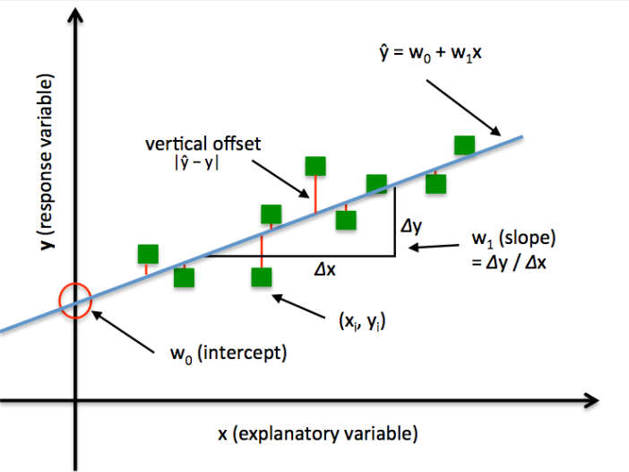
This task can be easily accomplished by Least Square Method. It is the most common method used for fitting a regression line.
It calculates the best-fit line for the observed data by minimizing the sum of the squares of the vertical deviations from each data point to the line. Because the deviations are first squared, when added, there is no cancelling out between positive and negative values.

Slide 16
Important Points:
There must be linear relationship between independent and dependent variables
Multiple regression suffers from multicollinearity, autocorrelation, heteroscedasticity.
Linear Regression is very sensitive to Outliers. It can terribly affect the regression line and eventually the forecasted values.
Multicollinearity can increase the variance of the coefficient estimates and make the estimates very sensitive to minor changes in the model. The result is that the coefficient estimates are unstable
In case of multiple independent variables, we can go with forward selection, backward elimination and step wise approach for selection of most significant independent variables.

Slide 17
Before attempting to fit a linear model to observed data, a modeler should first determine whether or not there is a relationship between the variables of interest.
This does not necessarily imply that one variable causes the other (for example, higher school scores do not cause higher college grades), but that there is some significant association between the two variables.
A scatterplot be a helpful tool in determining the strength of the relationship between two variables. If there appears to be no association between the proposed explanatory and dependent variables (i.e., the scatterplot does not indicate any increasing or decreasing trends), then fitting a linear regression model to the data probably will not provide a useful model.

Slide 18
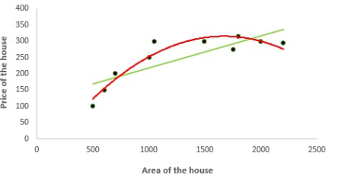

2. Polynomial Regression
It is a technique to fit a nonlinear equation by taking polynomial functions of independent variable.
In the figure given below, you can see the red curve fits the data better than the green curve. Hence in the situations where the relation between the dependent and independent variable seems to be non-linear we can deploy Polynomial Regression Models.
Thus a polynomial of degree k in one variable is written as:

Slide 19
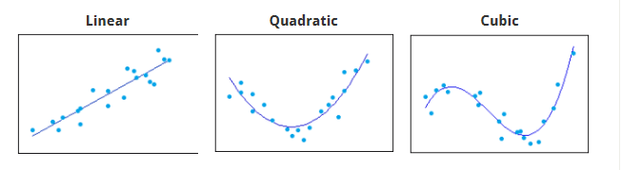
In case of multiple variables say X1 and X2, we can create a third new feature (say X3) which is the product of X1 and X2 i.e.
To determine the correct polynomial term to include, simply count the number of bends in the line.
Take the number of bends in your curve and add one for the model order that you need.
For example, quadratic terms model one bend while cubic terms model two.
In practice, cubic terms are very rare.
When you use polynomial terms, consider standardizing your continuous independent variables.

Slide 20
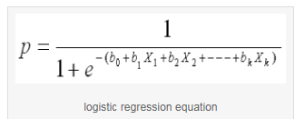
3. Logistic Regression
In logistic regression, the dependent variable is binary in nature (having two categories).
Independent variables can be continuous or binary.
In multinomial logistic regression, you can have more than two categories in your dependent variable.
Here my model is:-
logit(p) = b0 + b1X1 + b2X2 + ------ + bk Xk
where logit(p) = loge(p / (1-p))

Slide 21

The logistic regression model is of the form :-
It is called a generalized linear model not because the estimated probability of the response event is linear, but because the logit of the estimated probability response is a linear function of the parameters.
Linear means linear in betas (the coefficients) but no in x's (the independent variables), so as long as your betas are not non-linear, your model is linear.

Slide 22
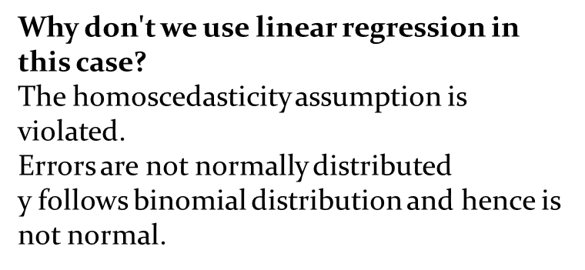

Slide 23
Logistic regression is used to find the probability of event=Success and event=Failure.
We should use logistic regression when the dependent variable is binary (0/ 1, True/ False, Yes/ No) in nature.
Here the value of Y ranges from 0 to 1 and it can represented by following equation.
odds= p/ (1-p) =probability of event occurrence / probability of not-event
occurrence
ln(odds) = ln(p/(1-p))
logit(p) = ln(p/(1-p)) = b0+b1X1+b2X2+b3X3....+bkXk
Above, p is the probability of presence of the characteristic of interest.

Slide 24
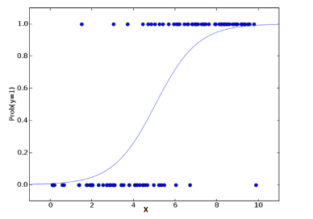
Since we are working here with a binomial distribution (dependent variable), we need to choose a link function which is best suited for this distribution. And, it is logit function.
In the equation above, the parameters are chosen to maximize the likelihood of observing the sample values rather than minimizing the sum of squared errors (like in ordinary regression).

Slide 25
Important Points:
It is widely used for classification problems
Logistic regression doesn’t require linear relationship between dependent and independent variables. It can handle various types of relationships because it applies a non-linear log transformation to the predicted odds ratio
To avoid over fitting and under fitting, we should include all significant variables. A good approach to ensure this practice is to use a step wise method to estimate the logistic regression
It requires large sample sizes because maximum likelihood estimates are less powerful at low sample sizes than ordinary least square
The independent variables should not be correlated with each other i.e. no multi collinearity. However, we have the options to include interaction effects of categorical variables in the analysis and in the model.
If the values of dependent variable is ordinal, then it is called as Ordinal logistic regression
If dependent variable is multi class then it is known as Multinomial Logistic regression.

Slide 26


4. Quantile Regression
Quantile regression is the extension of linear regression and we generally use it when outliers, high skeweness and heteroscedasticity exist in the data.
Quantile is same as Percentile. Quantiles refer to fractions (0.25) while percentiles refer to percents (25%). In linear regression, we predict the mean of the dependent variable for given independent variables.
Since mean does not describe the whole distribution, so modeling the mean is not a full description of a relationship between dependent and independent variables.
So we can use quantile regression which predicts a quantile (or percentile) for given independent variables. Basic Idea of Quantile Regression: In quantile regression we try to estimate the quantile of the dependent variable given the values of X's.
Note that the dependent variable should be continuous.
The quantile regression model:
For qth quantile we have the following regression model:

Slide 27
Interpreting the coefficients in quantile regression: Suppose the regression equation for 25th quantile of regression is:
y = 5.2333 + 700.823 x
In the end we have regression coefficients that estimate an independent variable’s effect on a specified quantile of our dependent variable.
It means that for one unit increase in x the estimated increase in 25th quantile of y by 700.823 units.
Advantages of Quantile over Linear Regression
Quite beneficial when heteroscedasticity is present in the data.
Robust to outliers
Distribution of dependent variable can be described via various quantiles.
It is more useful than linear regression when the data is skewed.

Slide 28
Regularization
Regularization
Regularization helps to solve over fitting problem which implies model performing well on training data but performing poorly on validation (test) data.
Regularization solves this problem by adding a penalty term to the objective function and control the model complexity using that penalty term.
We do not regularize the intercept term. The constraint is just on the sum of squares of regression coefficients of X's. Regularization is generally useful in the following situations:
Large number of variables
Low ratio of number observations to number of variables
High Multi-Collinearity
2. L1 Loss function or L1 Regularization
In L1 regularization we try to minimize the objective function by adding a penalty term to the
sum of the absolute values of coefficients. This is also known as least absolute deviations
method. Lasso Regression makes use of L1 regularization.
3. L2 Loss function or L2 Regularization
In L2 regularization we try to minimize the objective function by adding a penalty term to the sum of the squares of coefficients. Ridge Regression or shrinkage regression makes use of L2 regularization.

Slide 29

Lasso Regression
Similar to Ridge Regression, Lasso (Least Absolute Shrinkage and Selection Operator) also penalizes the absolute size of the regression coefficients.
Lasso regression used L1 regularization
In addition, it is capable of reducing the variability and improving the accuracy of linear regression models.
Lasso regression differs from ridge regression in a way that it uses absolute values in the penalty function, instead of squares.
This leads to penalizing (or equivalently constraining the sum of the absolute values of the estimates) values which causes some of the parameter estimates to turn out exactly zero.
Larger the penalty applied, further the estimates get shrunk towards absolute zero.
This results to variable selection out of given n variables.

Slide 30
Important Points:
Lasso regression can perform in-built variable selection as well as parameter shrinkage.
While using ridge regression one may end up getting all the variables but
with Shrinked Paramaters.
The assumptions of this regression is same as least squared regression except normality is not to be assumed
It shrinks coefficients to zero (exactly zero), which certainly helps in feature selection
This is a regularization method and uses l1 regularization
If group of predictors are highly correlated, lasso picks only one of them and shrinks the others to zero

Slide 31
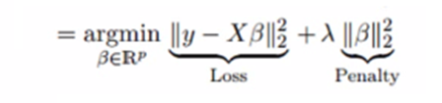
Ridge Regression
Ridge Regression is a technique used when the data suffers from multicollinearity
( independent variables are highly correlated).
Ridge regression uses L2 regularization.
In multicollinearity, even though the least squares estimates (OLS) are unbiased, their variances are large which deviates the observed value far from the true value.
By adding a degree of bias to the regression estimates, ridge regression reduces the standard errors.
This equation has an error term. Error term is the value needed to correct for a prediction error between the observed and predicted value
y=a+b*x+e (error term)
=> y=a+y= a+ b1x1+ b2x2+....+e, for multiple independent variables

Slide 32


In a linear equation, prediction errors can be decomposed into two sub components.
First is due to the bias and second is due to the variance.
Prediction error can occur due to any one of these two or both components. Here, we’ll discuss about the error caused due to variance.
Ridge regression solves the multicollinearity problem through Shrinkage Parameter λ (lambda).
In this equation, we have two components. First one is least square term and other one is lambda of the summation of β2 (beta- square) where β is the coefficient. This is added to least square term in order to shrink the parameter to have a very low variance.

Slide 33
Important Points:
The assumptions of this regression is same as least squared regression except normality is not to be assumed
It shrinks the value of coefficients but doesn’t reaches zero, which suggests no feature selection feature
This is a regularization method and uses l2 regularization.

Slide 34

Elastic Net Regression
ElasticNet is hybrid of Lasso and Ridge Regression techniques.
It is trained with L1 and L2 prior as regularizer.
Elastic-net is useful when there are multiple features which are correlated.
Lasso is likely to pick one of these at random, while elastic-net is likely to pick both.
A practical advantage of trading-off between Lasso and Ridge is that, it allows Elastic-Net to inherit some of Ridge’s stability under rotation.

Slide 35
Selection of Right Regression Model
First step before selecting the right model is to identify the relationship and impact of variables
To compare the goodness of fit for different models, we can analyse different metrics like statistical significance of parameters, R-square, Adjusted r-square, AIC, BIC and error term. Another one is the Mallows Cp criterion.
This essentially checks for possible bias in your model, by comparing the model with all possible submodels (or a careful selection of them).
Cross-validation is the best way to evaluate models used for prediction. Here you divide your data set into two group (train and validate). A simple mean squared difference between the observed and predicted values give you a measure for the prediction accuracy.
Regression regularization methods(Lasso, Ridge and ElasticNet) works well in case of high dimensionality and multicollinearity among the variables in the data set.

Slide 36
Appendix
Residual plots:- Box plot and Tukey’s method:-
Cross-Validation:- Ridge and Lasso Regression:-
Regularization:-
Types of Distributions:-
Other Types of Regression:-

Slide 37
Thank You !!

